Slide 1
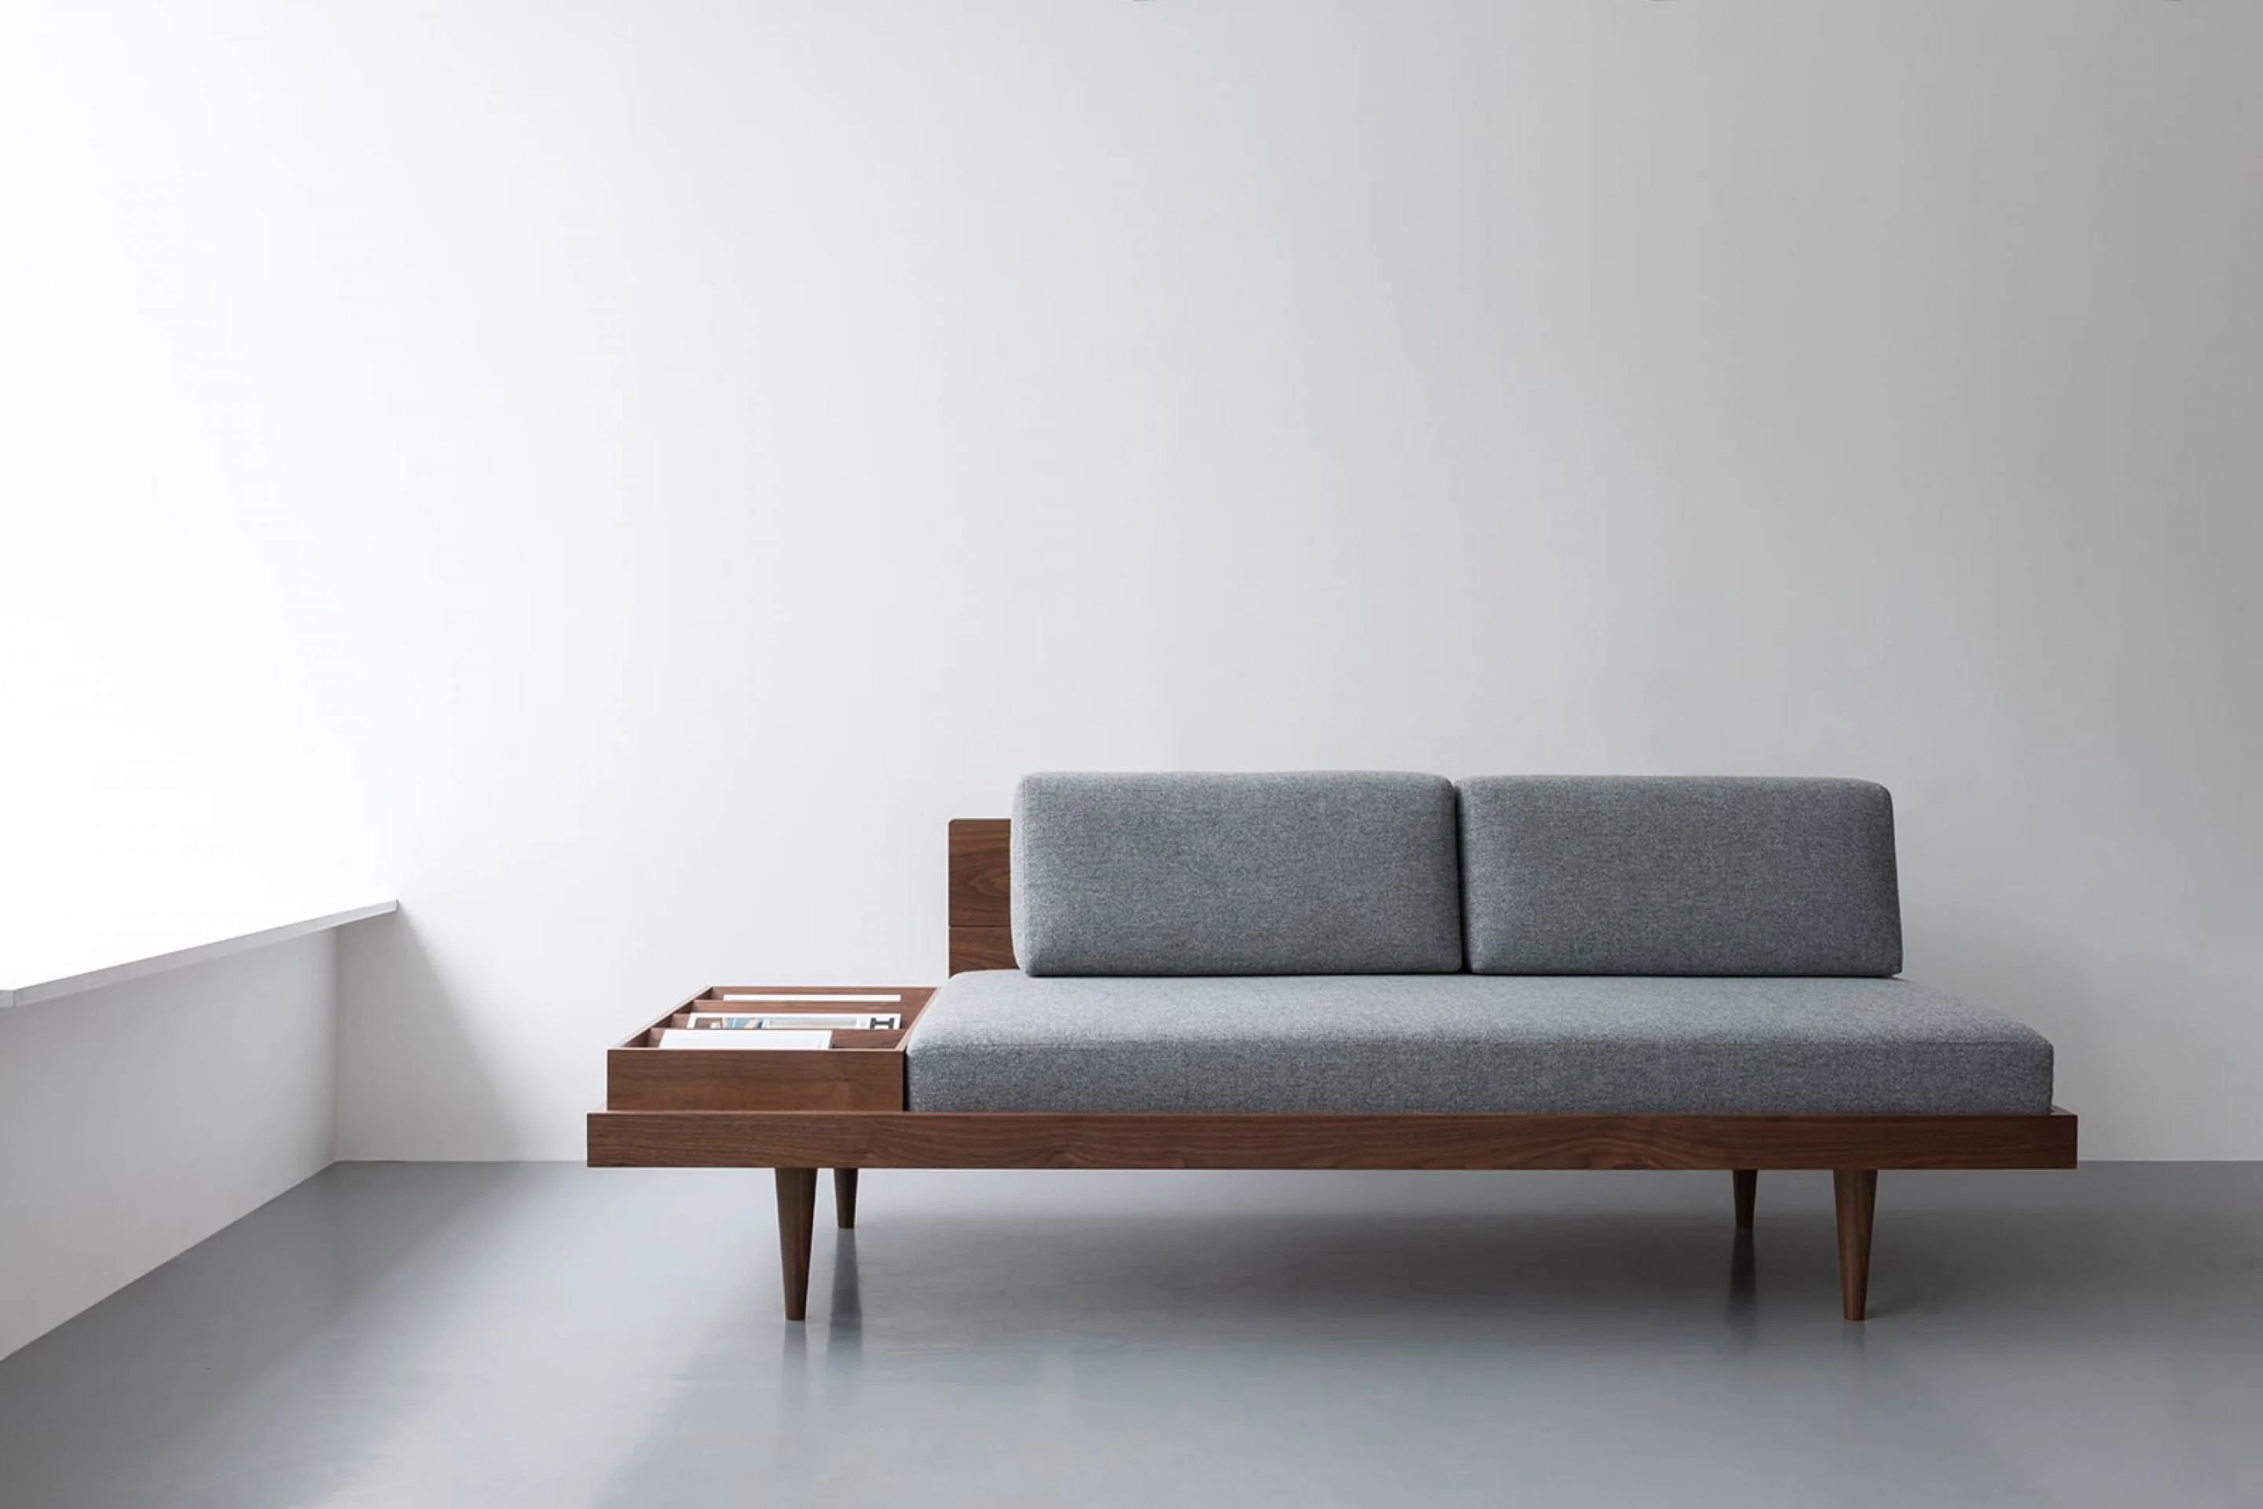
FurRent
Buy, rent, exchange furniture on the go.
Alireza Samadi, 1961823
Fariba Noorighomesheh, 1958130
Nilesh Dusane, 2021621
Smeet Nilvarna, 2007270
Ali Raza Mahar, 1989534

Slide 2
Problems
People tend to buy cheap quality furniture due to the unaffordable prices.
Transportation and assembly is a problem for the people who relocate in at most 18 months on average.
For the people who are relocating on a yearly basis, it is not financially convenient to buy new furniture.
Furniture waste: Over 9 million tons of furniture is tossed away every year.

Slide 3
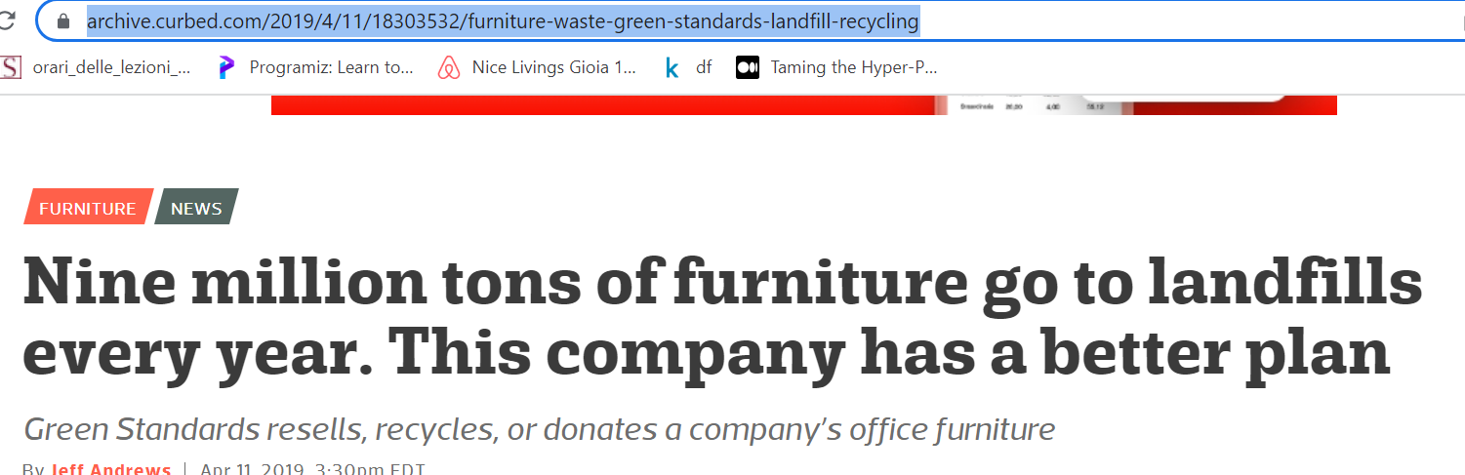
Problems
Furniture waste: Over 9 million tons of furniture is tossed away every year.
can be confirmed by a simple internet search
Test 4

Slide 4

Evaluating other Problems through two Questionnaires

Slide 5
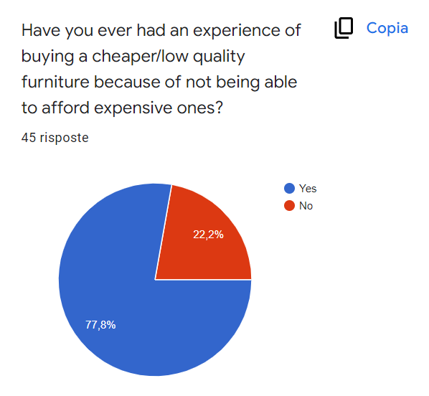
Problems
People tend to buy cheap quality furniture due to the unaffordable prices.
Test 3

Slide 6
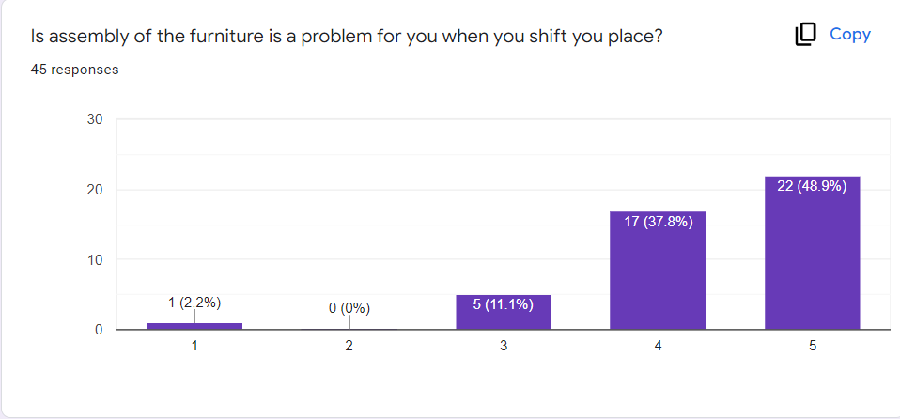
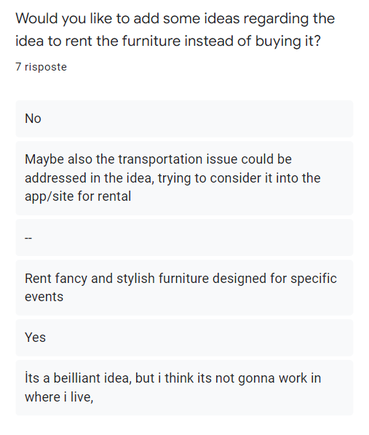
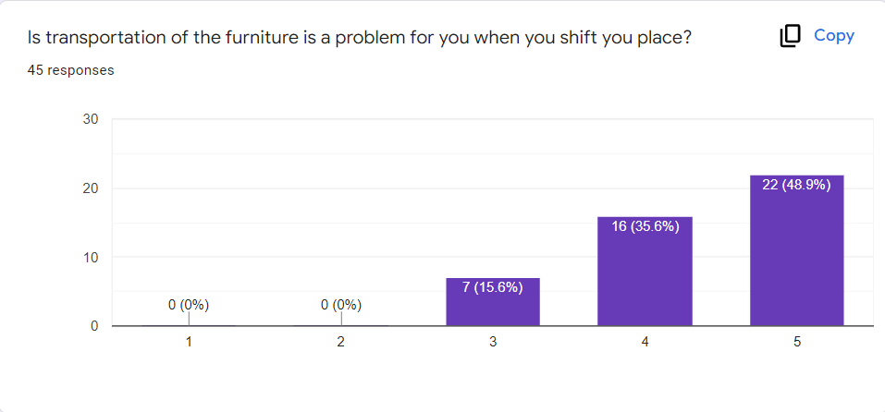
Problems
Transportation and assembly is a problem for the people who relocate in at most 18 months on average.
Based on the first questionnaire
Based on the second questionnaire ( targeted responders)

Slide 7
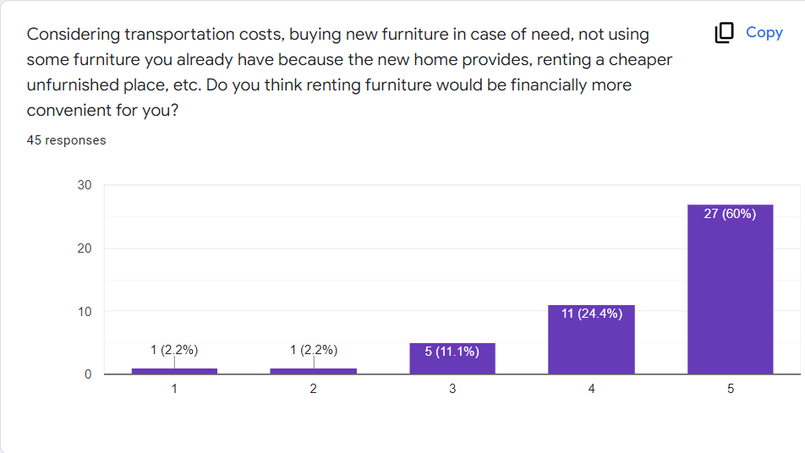
Problems
For the people who are relocating on a yearly basis, it is not financially convenient to buy new furniture.

Slide 8

Problems are actually problems!!!
People tend to buy cheap quality furniture due to the unaffordable prices. [Confirmed]
Transportation and assembly is a problem for the people who relocate in at most 18 months on average. [Confirmed]
For the people who are relocating on a yearly basis, it is not financially convenient to buy new furniture. [Confirmed]
Furniture waste: Over 9 million tons of furniture is tossed away every year. [Confirmed]

Slide 9
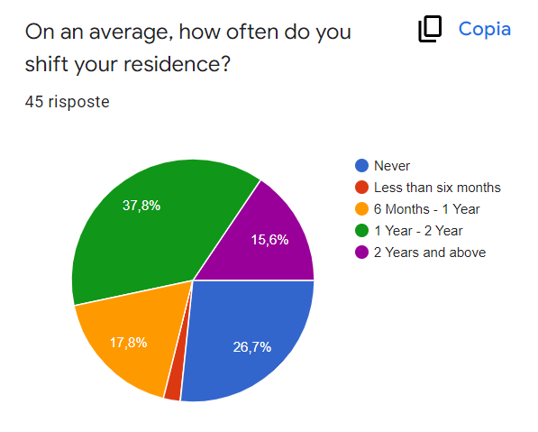
Other Key points derived from questionnaire to be addressed by the product :
Majority of population change their living place, on an average at most every 1 to 2 years.
Test 1

Slide 10
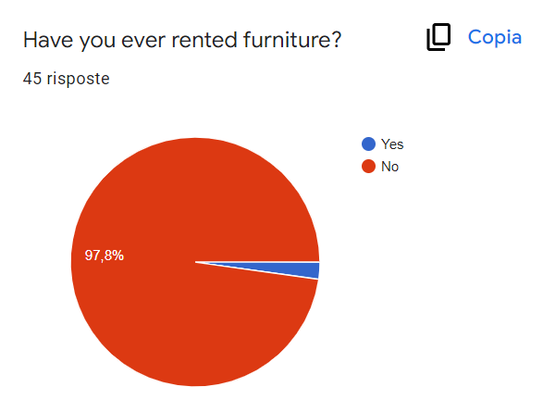
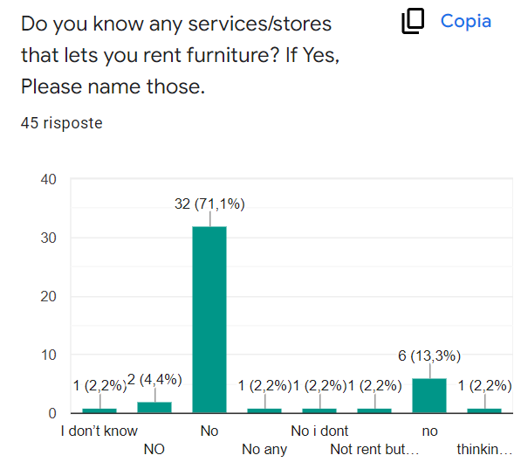
Other Key points derived from questionnaire to be addressed by the product :
No well known competitor is available as of now.

Slide 11
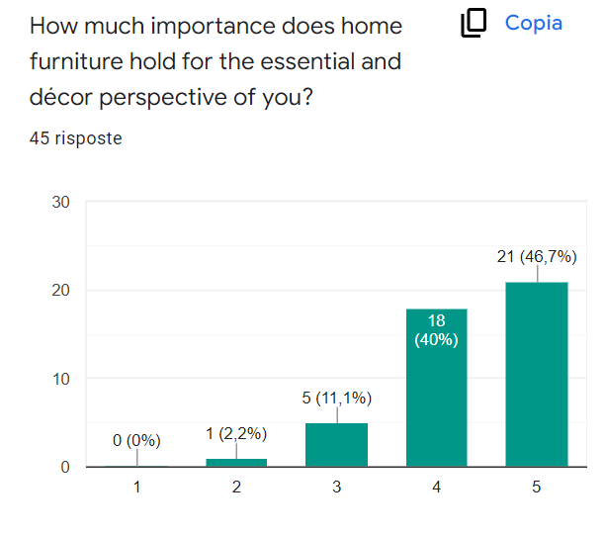
Other Key points derived from questionnaire to be addressed by the product :
Being decorative and stylish is a key element of a furniture for people.
Test 6

Slide 12
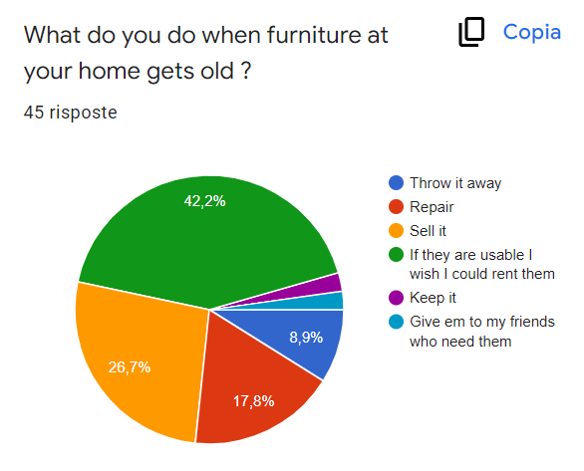
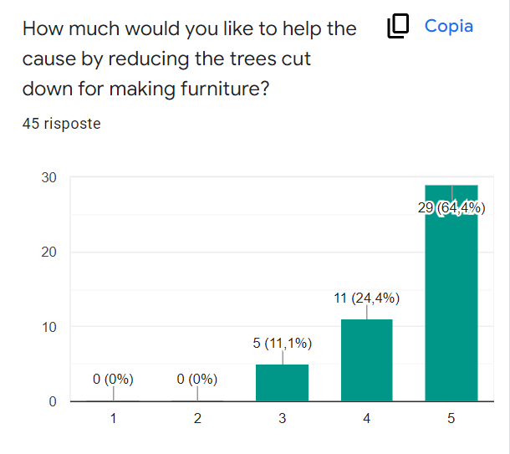
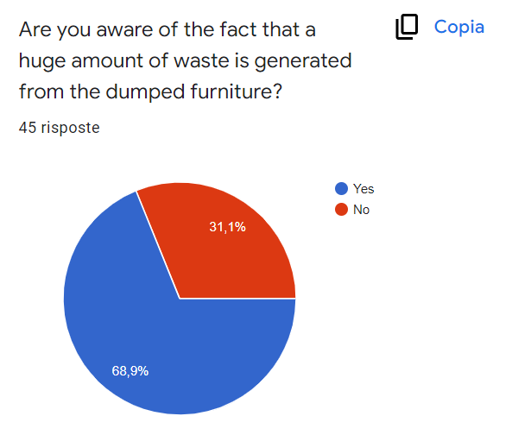
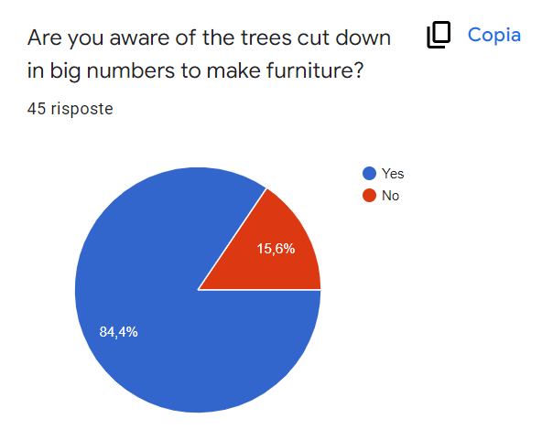
Other Key points derived from questionnaire to be addressed by the product :
Around 10% of the respondent threw away their unused furniture resulting in furniture waste.
Considering above people still care about helping their environment.

Slide 13
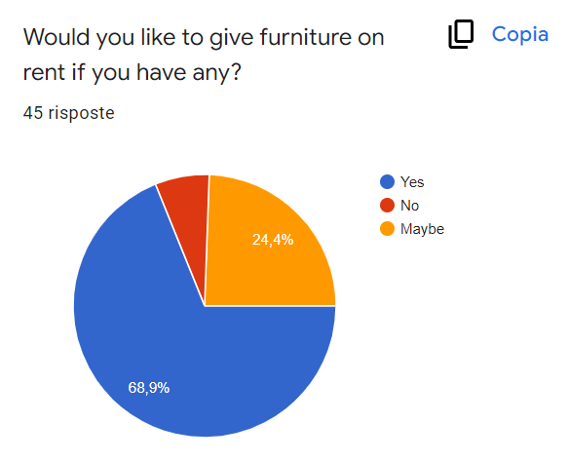
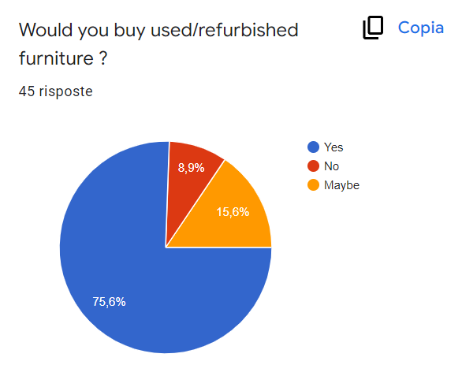
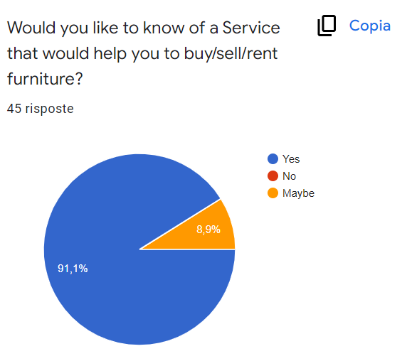
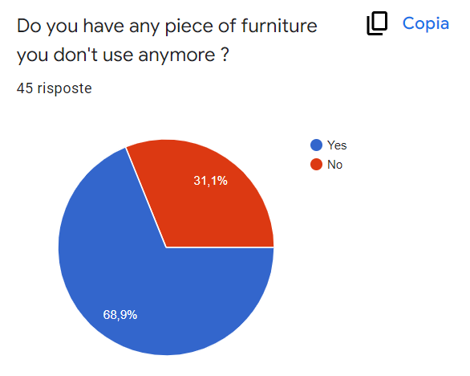
Other Key points derived from questionnaire to be addressed by the product :
The product can be explored more to be expanded later to a product that even people can rent furniture from other users

Slide 14
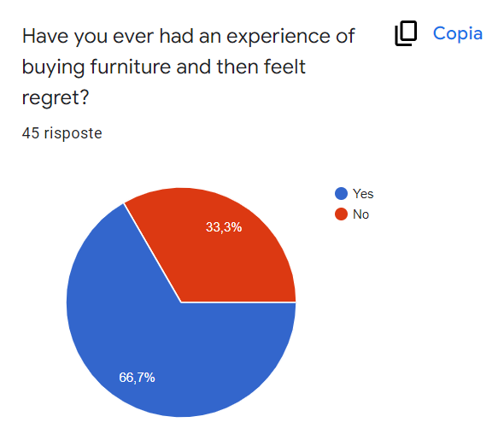
Other Key points derived from questionnaire to be addressed by the product :
People might change their idea after buying a permanent product
Test 2

Slide 15

Summary
People tend to buy cheap quality furniture due to the unaffordable prices.
Transportation and assembly is a problem for the people who relocate in at most 18 months on average.
For the people who are relocating on a yearly basis, it is not financially convenient to buy new furniture.
Furniture waste: Over 9 million tons of furniture is tossed away every year.
No well known competitor is available as of now.
Being decorative and stylish is a key element of a furniture for people.
people still care about helping their environment.
People might change their idea after buying a permanent product

Slide 16
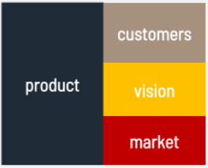
Business Concept

Slide 17
WHAT? (The Product) :
FurRent fits the way we live today.…
WHO? (Current Problem of people):
City renters move on average every 1-2 years. [T1]Tastes evolve, living arrangements change,[T2 ] budgets fluctuate, and many can’t afford or don’t want to commit to quality furniture so they end up resorting to cheaper alternatives that aren’t built to last.[T3]
As a result, 9 million tons of furniture end up in landfills annually (that’s about the same amount of plastic that ends up in the oceans every year) [T4].
( Problem of the Environment ) :
WHAT? (The Product : A solution to Problem of people and the environment)
FurRent is Affordable, well-made, Convenient, and sustainable .Smart and stylish[T5] with a more responsible approach to furniture, which is based on rental, reuse, and refurbishment. Using FurRent is as simple as you expect: Choose your furniture Decide if you want to rent or buy, Get your items delivered and assembled and Experience furniture magic firsthand.[T6]
WHY?(The vision)
The concept of Renting your furniture gives you flexibility and a stress-free way of changing your space, but if you are looking for a long-term, “forever” option FurRent still offers buying as a great option.
The Market:
….. To be completed ….

Slide 18
Is FurRent the first to rent furniture ?

Slide 19
NO

Slide 20
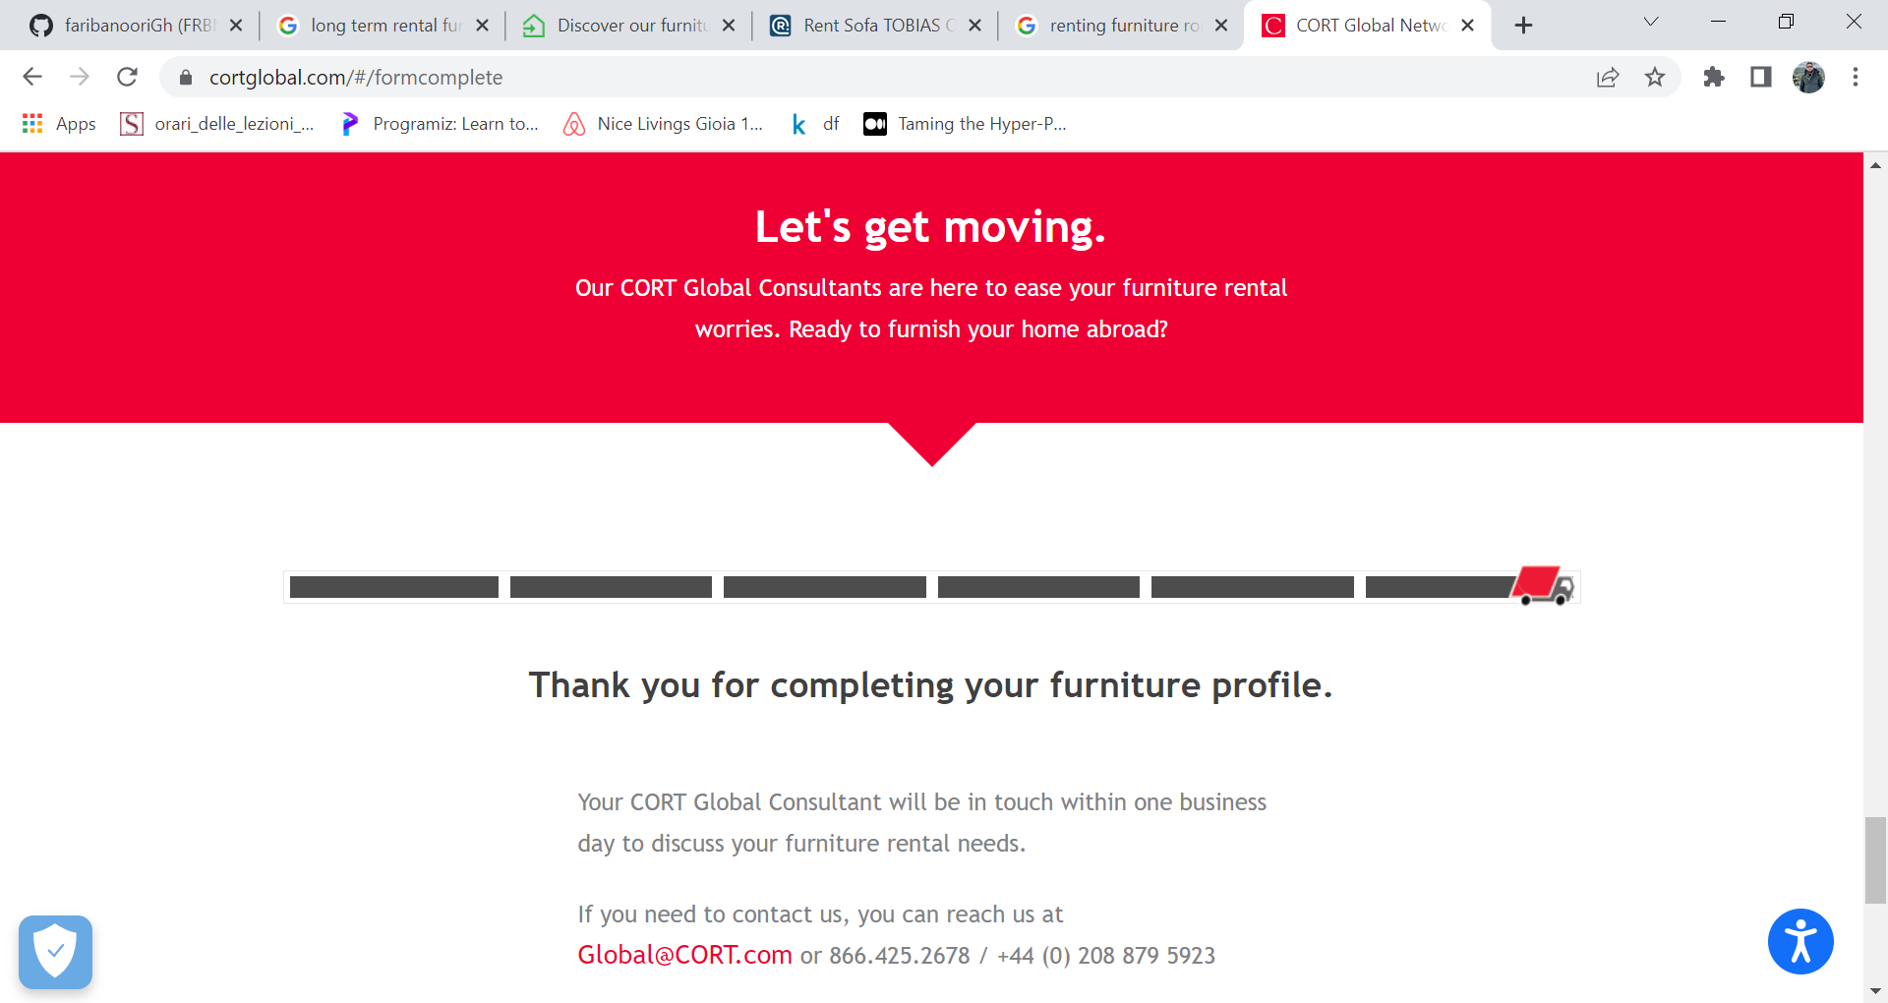

Slide 21
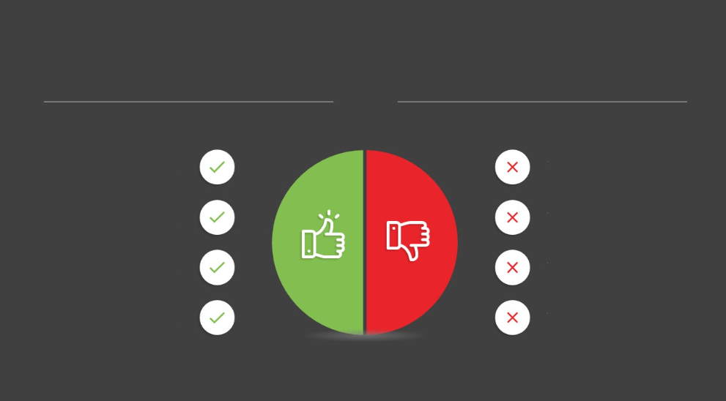

CortGlobal.com
Nothing related to furniture is shown
You should register and wait for the call
Cannot be evaluated by user before giving personal information
First google search result
Offering Service in many countries

Slide 22
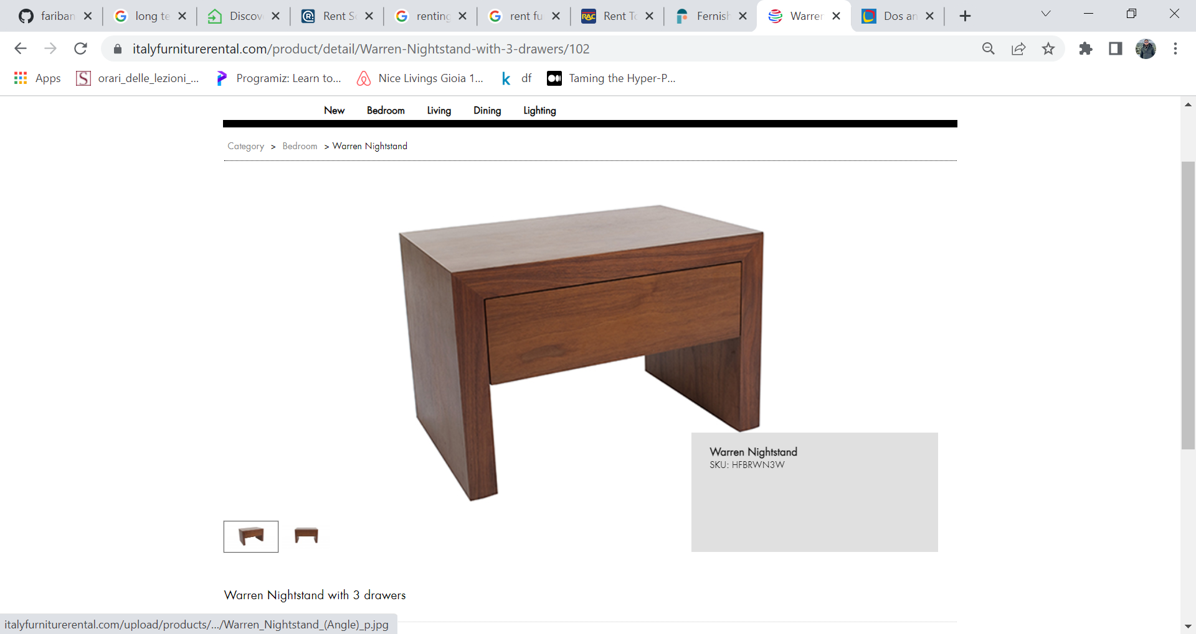

Slide 23
https://www.italyfurniturerental.com/
Very old fashioned website
No price is shown!
Very Old fashioned furniture
First google result for italy
Offering variety of furniture

Slide 24
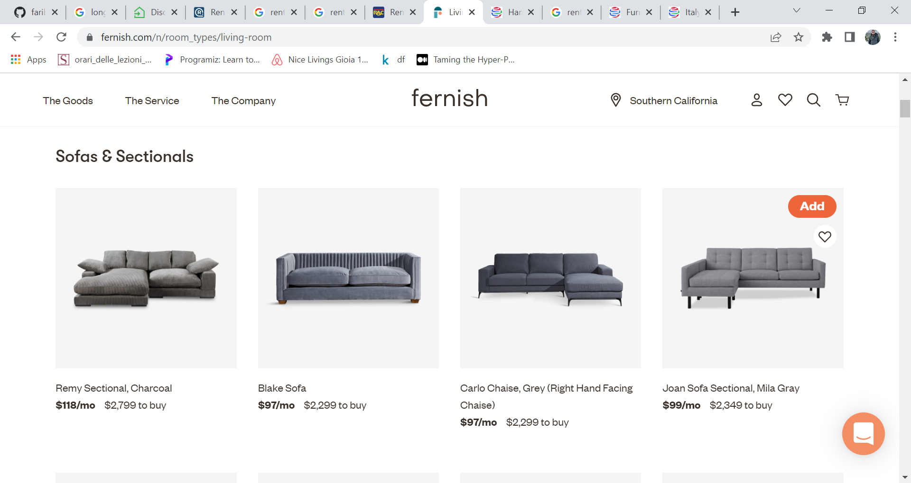

Slide 25
Fernish.com
Nice website
Not available in italy
Price for short term seems still high
You cant buy furniture in middle of contract
Offering variety of furniture
Offering stylish furniture
Price is less for longer contracts
you can also buy furniture

Slide 26
Many Other Similar Solutions
Nice website
Still not available in italy
Price for short term seems still high
Very Old fashioned furniture
You cant buy furniture in middle of contract
Offering variety of furniture
Offering stylish furniture
Price is less for longer contracts
you can also buy furniture

Slide 27



Alternatives
There are familiar alternatives for the problems associated to furniture
Used Furniture can be sold and bought
Offers also reasonable price and reasonable quality furniture

Slide 28
Cost Structure
The cost of Furrent goes into buying and keeping furnitures in their franchises and also furnishing & Refurbishing the used furnitures.
It also spends on the advertisement and marketing of products.
The cost structure also includes transportation and labor costs for delivering and assembling the furniture.

Slide 29
Revenue Structure
Furrent franchises pay the firm per cent basis annual royalty on their net sales.
Furrent makes money through renting and sale of furniture & other revenue in addition to the franchise fees. Furniture rented or sold by Furrent franchises are related to the wholesale sale of Furrent products.
Other revenue consists mostly of money from the Furrent catalog and other Furrent marketing materials. Furrent made revenues of franchise charges, merchandise sales, and other service fees including assembly and delivery fees.

Slide 30
Unique Value Preposition
The idea behind Furrent is to provide a premium and hassle-free experience for everyone. With renting as the focus you are also contributing towards reducing the furniture waste and making environment alive again.
No life-time of commitment to the one furniture, change it as your taste changes.
And if you like the furniture pay the amount and it’s yours.
The delivery and assembly is always on us.

Slide 31
Market Size

Slide 32
TAM
€500,000,000
The total available market in our case would be every household in Italy that will buy/rent furniture.
The average number of households: Estimated by population of Italy /3 = €20,000,000
Average renting cost per month = €(50-200)
We’ll consider the average renting cost (not necessarily for one furniture) = € 100
Average monthly expenses of furniture: (manufacturing/buying them by FurRent + delivering + other expenses ) = 75
Therefore, revenue from TAM = 25*20,000,000 = € 500,000,000

Slide 33
TAM
€500,000,000
The serviceable available market in our case would be the people who are present in our geographical reach, so, the household of Rome, who want to buy/rent their furniture.
Therefore, our SAM would be = 2.9 million/3 = 1,000,000
Average renting cost per month = €(50-200)
We’ll consider the average renting cost (not necessarily for one furniture) = €100
Average monthly expenses of furniture: ( manufacturing/buying them by FurRent + delivering + other expenses ) = 75
Therefore, revenue from SAM = 25*1,000,000 = €25,000,000
SAM
€25,000,000

Slide 34
TAM
€500,000,000
The serviceable obtainable market would be the people who are foreigners, relocators, students, or people who live on a rented basis who will constantly use our services to relocate their furniture from a place to another, or also, rent their furniture as their residence is not permanent.
Around 21% of population of Rome lives in a rented house =609,000
Are foreigners, relocators, students, or people who live on a rented basis estimated to be = 609000/2
We’ll consider the average renting cost (not necessarily for one furniture) = €100
Average monthly expenses of furniture: (manufacturing/buying them by FurRent + delivering + other expenses ) = 75
Therefore, revenue from SOM – 25*300,000 = 7,500,000 *18 = €135,000,000
SAM
€25,000,000
SOM
€135,000,000

Slide 35
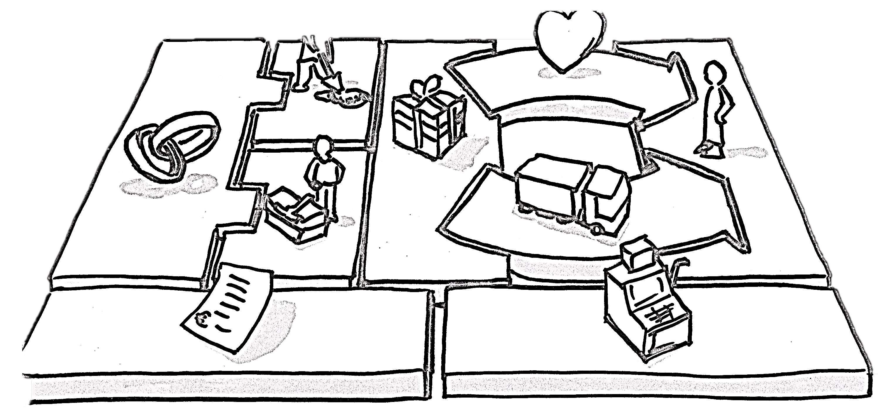
Lean Canvas

Slide 36
Problem | Solution | Unique Value Proposition |  | Unfair Advantage | Customer Segments
Top 3 problems Finding the suitable furniture for time being for an event/activity. Purchasing furniture is unaffordable for many people. Required furniture might be useless after a while Furniture waste | Top 3 features Get furniture on rent. Sell your unused furniture to others. Give it someone for FREE! | Get the premium renting experience of high-quality and stylish furniture without compromising your budget with the period of your choice. Choose from the catalog, select the renting period, select the time and date, pay a dime and get it delivered. Done using it, set an appointment for return and pickup, we will take care of everything. |  | Many photos Pay the difference and own it Very high durability | Tourists Expats Foreign students Even landlords(ex. who want to offer a flexible place of renting)
Existing Alternatives | Key Metrics | High-Level Concept |  | Channels | Early Adopters
CortGlobal Italyfurniturerental Fernish(Not available in Italy) Subito Kijiji IKEA | The number of active users | Furniture renting/buying platform over the internet |  | Website iOS Application Android Application | Foreign students. Landlords
Cost Structure |  |  | Revenue Structure
Inventory costs( buying /keeping furniture ) Logistics. Advertisement Human Resource. |  |  | Renting/selling Service fees.

Slide 37
Thank you for your Attention
https://docs.google.com/forms/d/1HlIvSOQPP6owG2YbMAQmZVEmtfkdfrqhxIOyiOmtFNk/edit?usp=sharing

